Slide 1
HYDRA
Hypothesis-Guided Model Revision over Multiple Aligned Representations
Shiwali Mohan, Wiktor Piotrowski, Roni Stern, Jacob Le, Alexandre Perez, Sookyung Kim, Johan de Kleer, Matt Klenk
Eric Eaton, Jorge Mendez, Meghna Gummadi (UPenn)
AI Birds Competition – Novelty Track, IJCAI 2021

Slide 2
Our Approach - HYDRA
Hypothesis-Guided Model Revision over Multiple Aligned Representations
Model-based novelty response method combining Learning, Planning, Model-based Diagnosis, and Model Revision.
Learning allows for detecting novel objects/conditions and predicting outcomes of actions.
Planning provides a rich, extensible model of the world and its dynamics, and a method for solving Angry Birds levels.
Model-based Diagnosis & Model Revision enables rapid adaptation to novelty and identifying the root cause of model discrepancies.

Slide 3
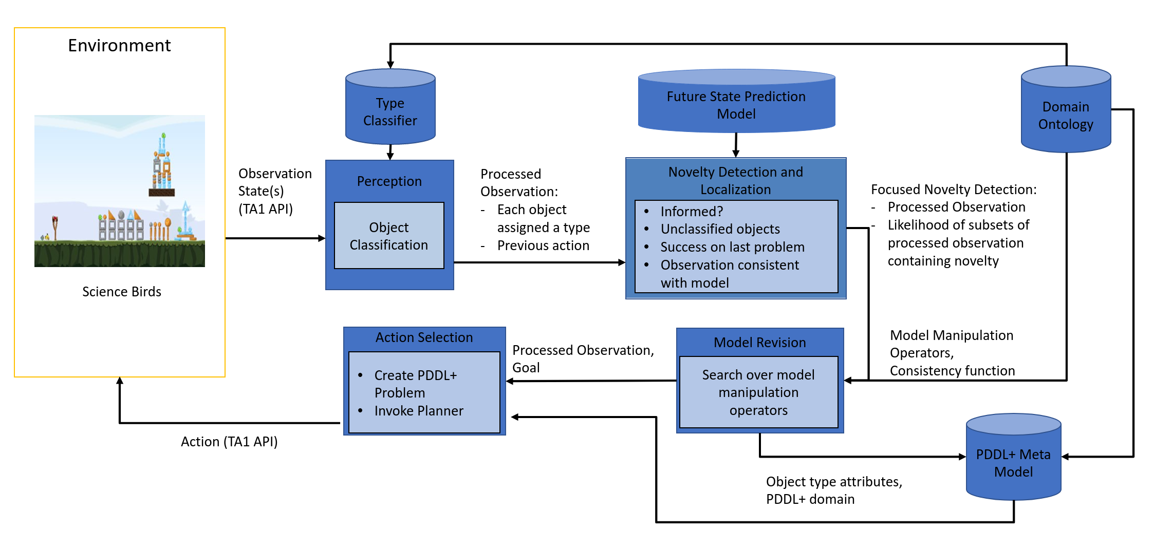
HYDRA Architecture Overview
Angry Birds

Slide 4
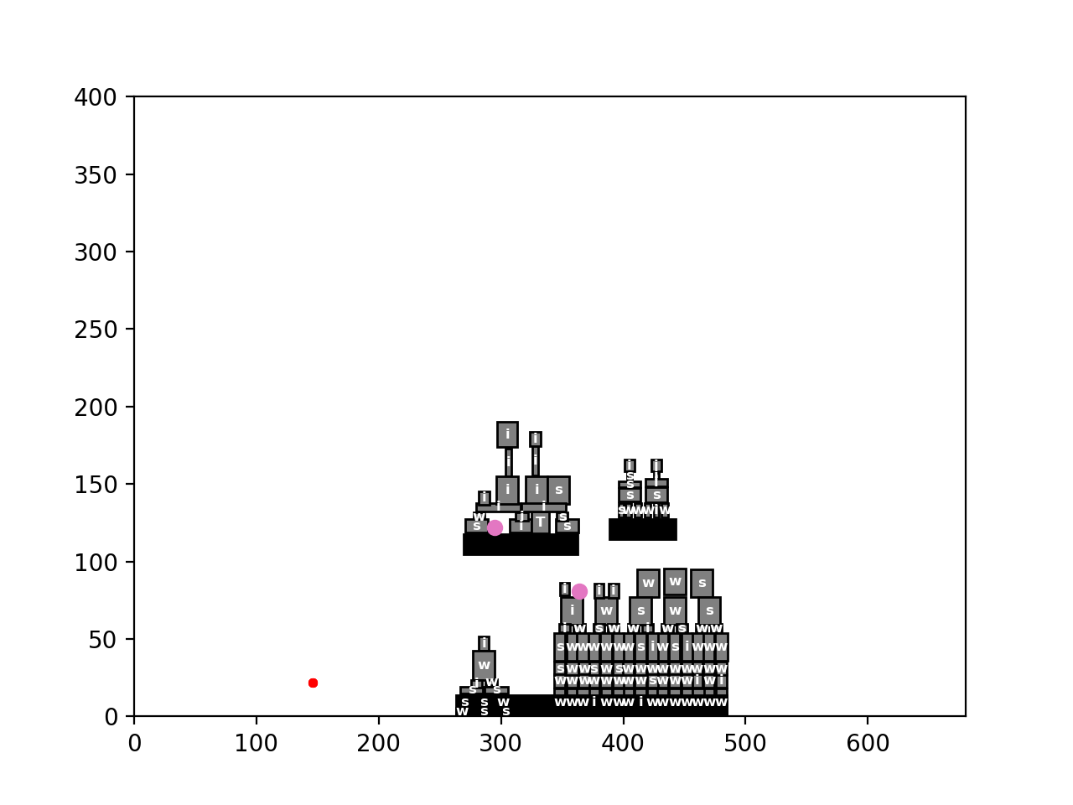
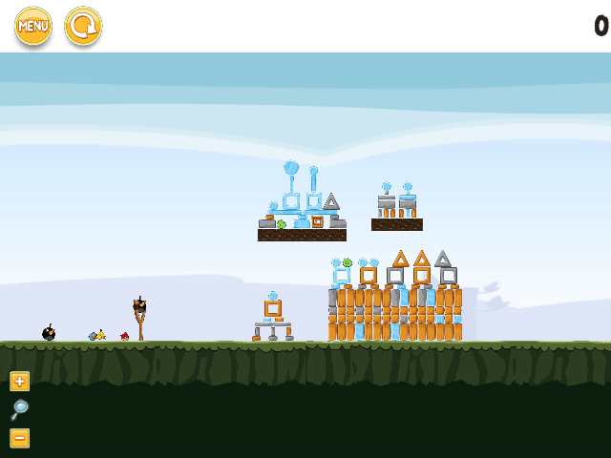
AI Planning for Angry Birds
AI Planning is the central component of HYDRA, tasked with both modelling and solving Angry Birds levels.
PDDL+ is a feature-rich compositional modelling language that expresses the structure & dynamics of discrete-continuous environments with exogenous activity.
Capable of capturing crucial aspects of the game environment, without supplemental external components/functions.
Provides a theory of novelty via changes in the PDDL+ model of the environment (most novelties change only a small subset of the model).
Solved by an off-the-shelf PDDL+ planner (UPMurphi/Nyx).

Slide 5
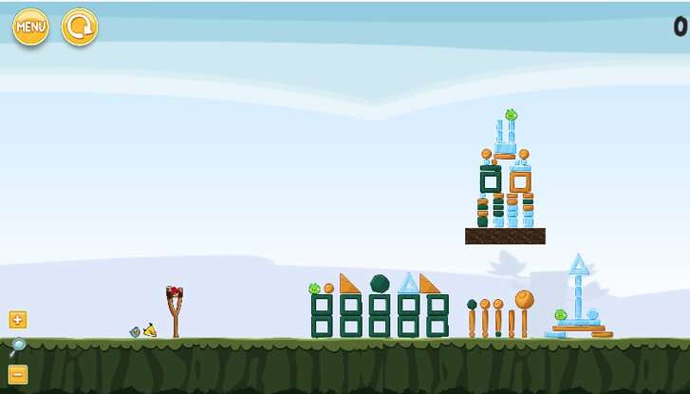
Novelty Detection & Localization
Future State Prediction (trained CNN).
Visual Information (i.e. novel-looking unclassified objects).
Performance on previous levels.
Consistency of Observations vs Expectation.
Bird trajectories: observed, simulated

Slide 6
Novelty Adaptation: Model-Based Diagnosis & Repair of the PDDL+ Model
Respond to novelty by reasoning over the difference between observations and expectations.
Define a finite set of model manipulation operations (MMOs).
Search the space of applying sequences of MMOs.
Objective function is consistency with observations.
Apply heuristic search (GBFS) to search efficiently.
Find a sequence of changes (MMOs) to the PDDL+ model, such that the simulated outcome of the plan matches the observations.
Bird trajectories: observed, simulated

Slide 7
Wiktor Piotrowski
wiktorpi@parc.com

